Slide 1

Pricing and advertising
Eknid Mucollari – Stefano Minotti

Slide 2
Scenario and environment
An e-commerce website specialized in fitness products has to face the problem of selling its new sport drink
Advertising
Pricing
Advertisement is used to attract users on the website
Unlimited budget for our campaign
Each new click involves a cost based on the advertising bid
New users will decide whether to buy or not the product at a certain price
Once a user makes a purchase it may come back and buy again the product at the same price during the following 30 days

Slide 3
Customer classes
Classes characterized by:
Number of daily clicks of new users as a function of the bid
Cost per click as a function of the bid
Conversion rate function providing the probability that a user will buy the product given a price
Distribution probability over the number of times a user will come back to buy the product during the next 30 days after his first purchase.
C1
C3
C2
Under 30
Sporty

Slide 4
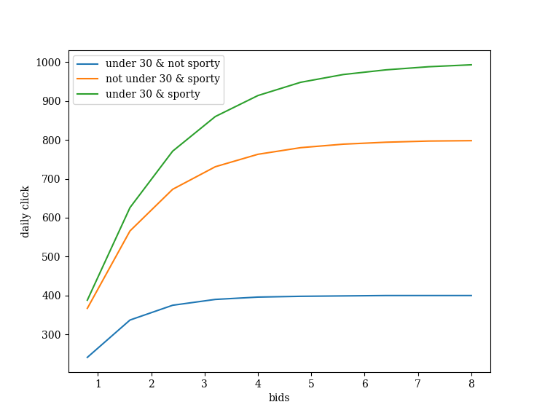
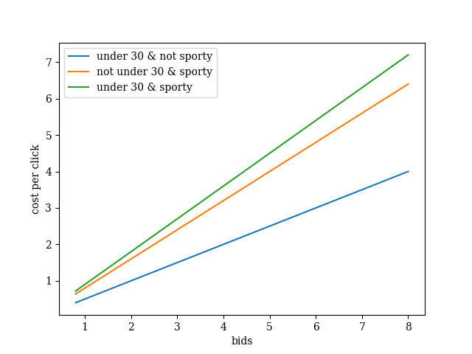
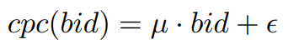
CLASS Functions
Daily clicks
Cost per click

Slide 5
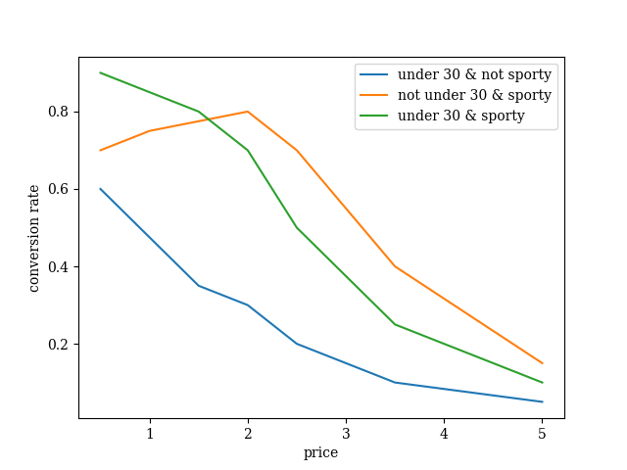
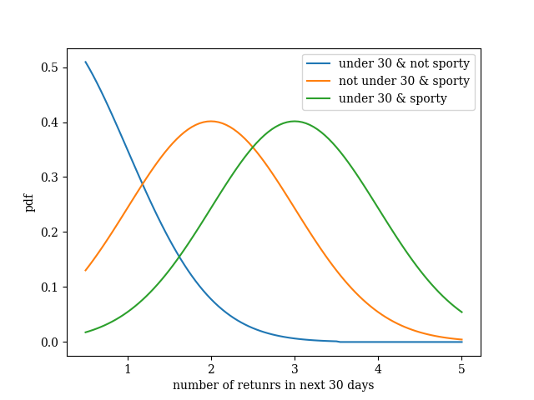
CLASS Functions
Conversion rate
Returns
Interpolation of points
Gaussian distribution

Slide 6
OBJECTIVE FUNCTION
For each customer class:
Iterate over all the prices and maximize the reward term that depends only on the price
Fix the best price and iterate over all the bids to maximize the full objective function
Complexity: O(#classes · (#prices + #bids))

Slide 7
Online learning
All the parameters of the objective function are unknown
Sets of candidate prices and bids
Each day select a pair of price and bid for each customer class, observe the realization of the unknown parameters and update our estimation on them
Delay in the feedback: the reward for a day will be available only after 30 days because it have to keep into consideration the number of times a user will return to buy the product in the 30 days after his first purchase

Slide 8
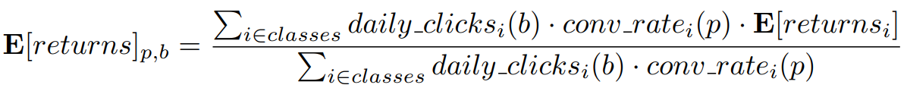
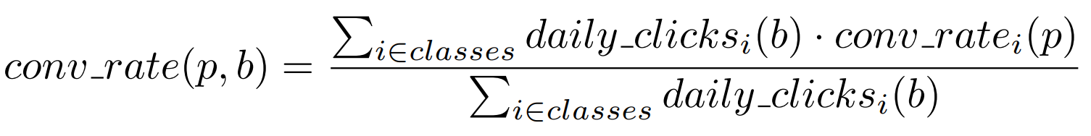
Aggregated Data
When working with aggregated data, considering two or more classes as a single one, the conversion rate and the expected returns will depend both on price and bid
Must be kept in mind especially when optimizing for both pricing and advertising

Slide 9
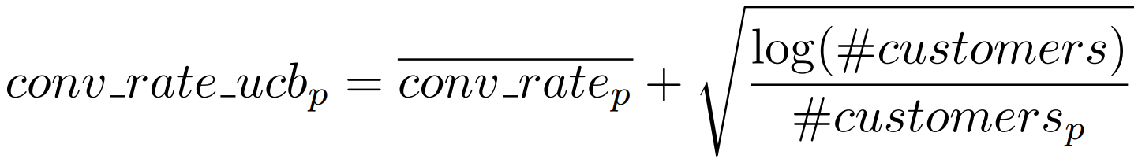
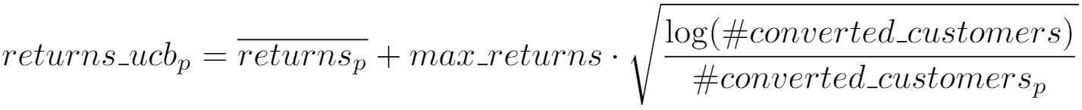
Pricing under fixed bid
Upper confidence bound
Thompson sampling
Conversion rate upper bound:
Expected returns upper bound:
At each round select price:
Beta distribution for conversion rate
Gaussian distribution for expected returns, parameters are mean and standard deviation of observations
At each round select price:
where conversion rate and returns are sampled from the distributions

Slide 10
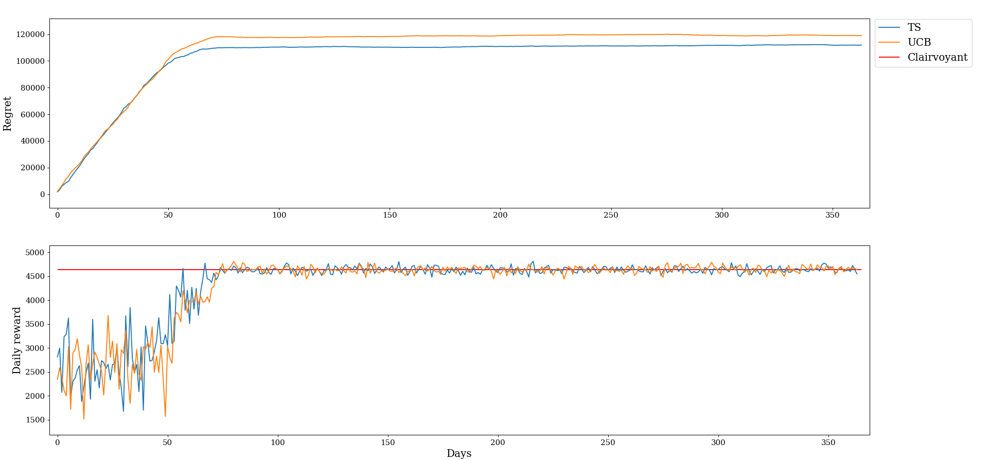
Pricing under fixed bid

Slide 11
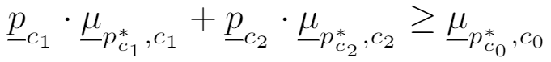
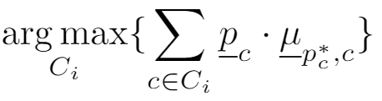
Pricing with discrimination
Greedy context generation
Brute-force context generation
Split a context if:
Select the split with the largest value
Iterate until there are splittable features
Enumerate all the possible context structures
Select the context structure such that:

Slide 12
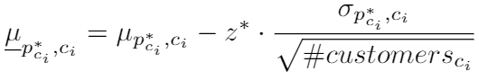
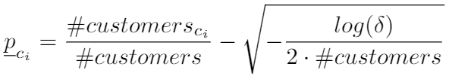
Pricing WITH DISCRIMINATION
Lower bound for the mean reward is:
Lower bound for the probability of a context is:
Two variants for both the algorithms:
Incremental generation
Generation from scratch

Slide 13
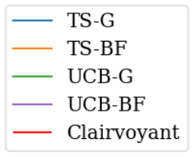
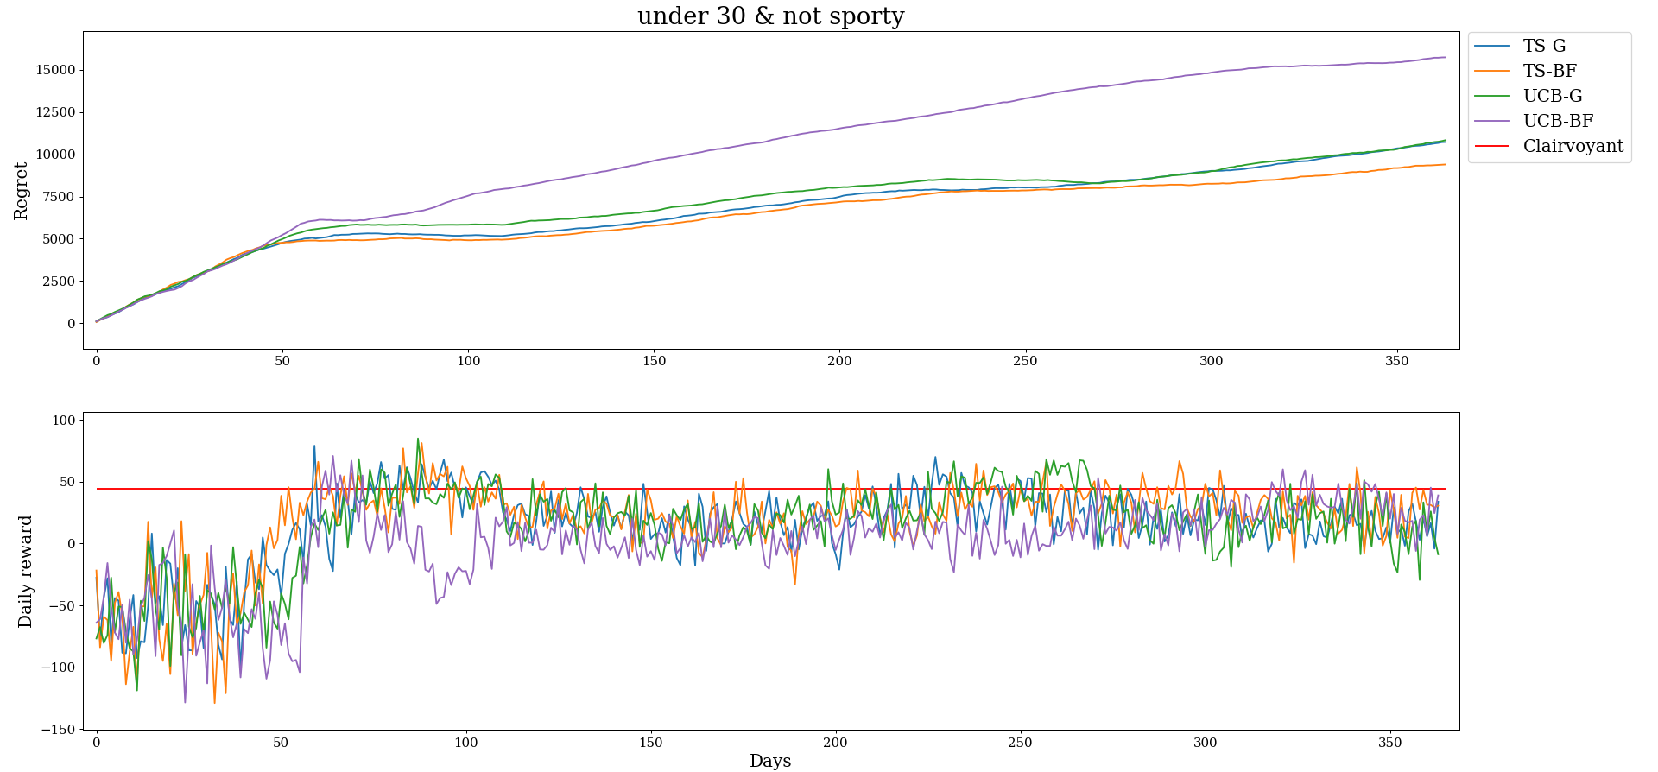
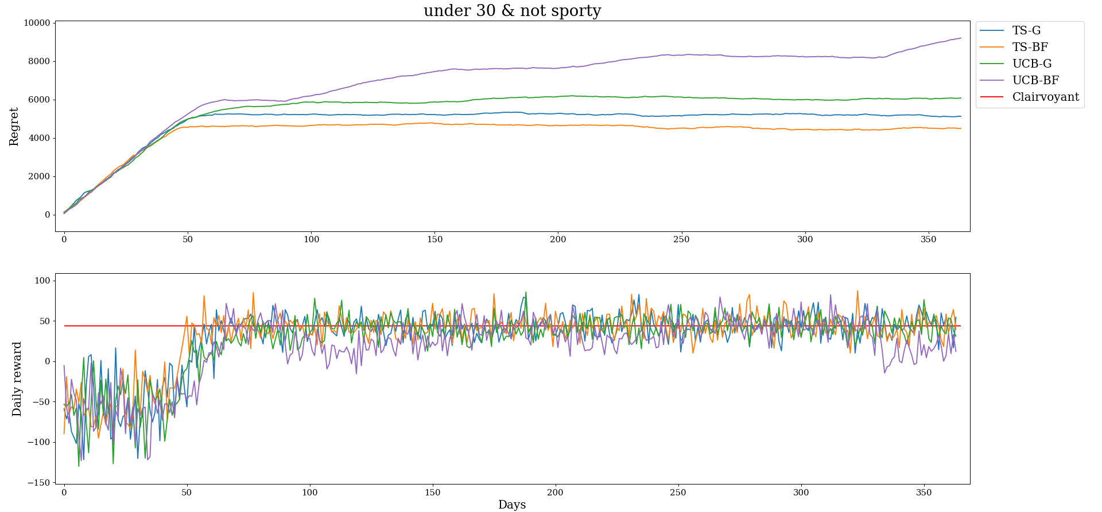
Pricing with discrimination
Generation from scratch
Incremental generation

Slide 14
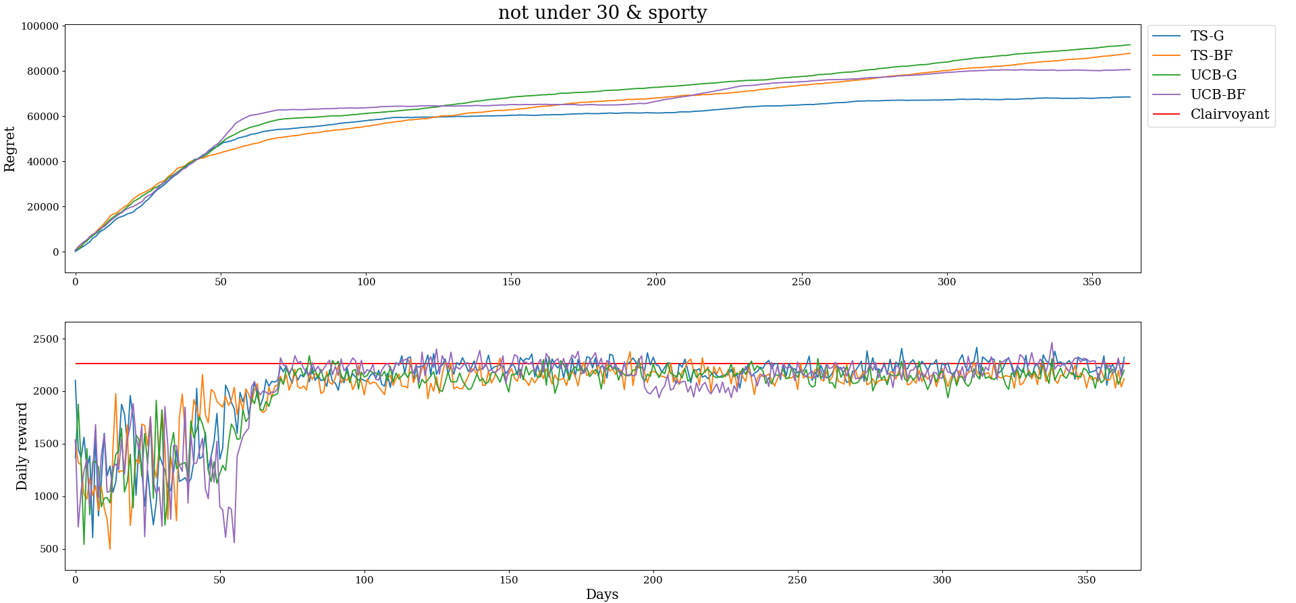
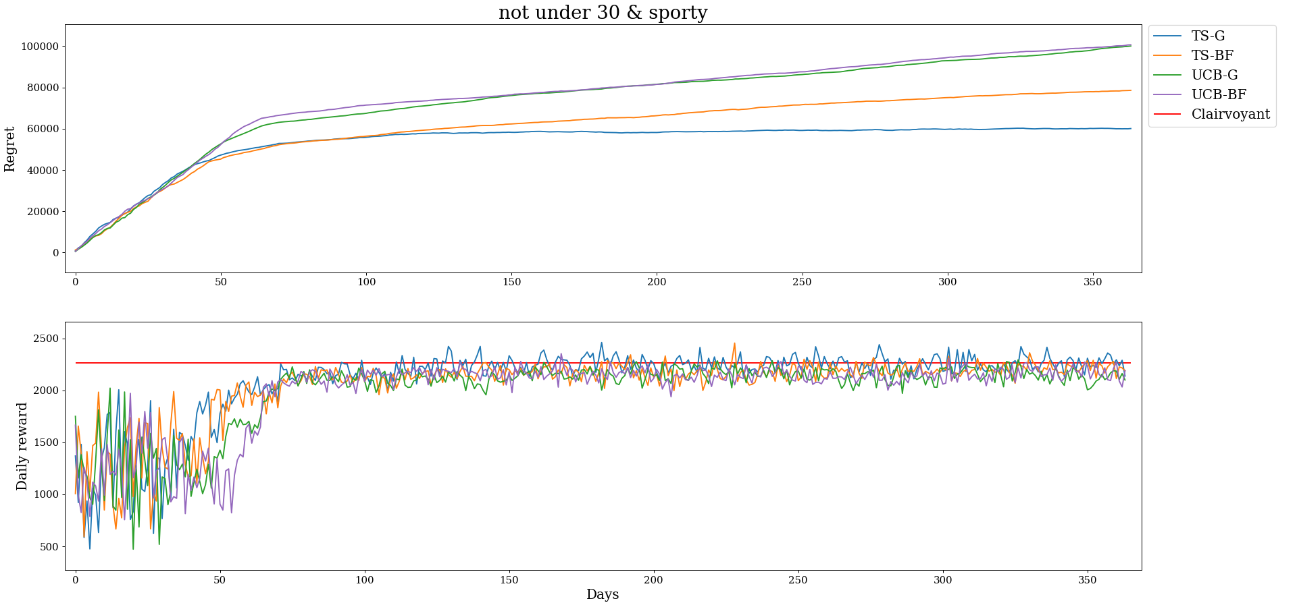
Pricing with discrimination
Generation from scratch
Incremental generation

Slide 15
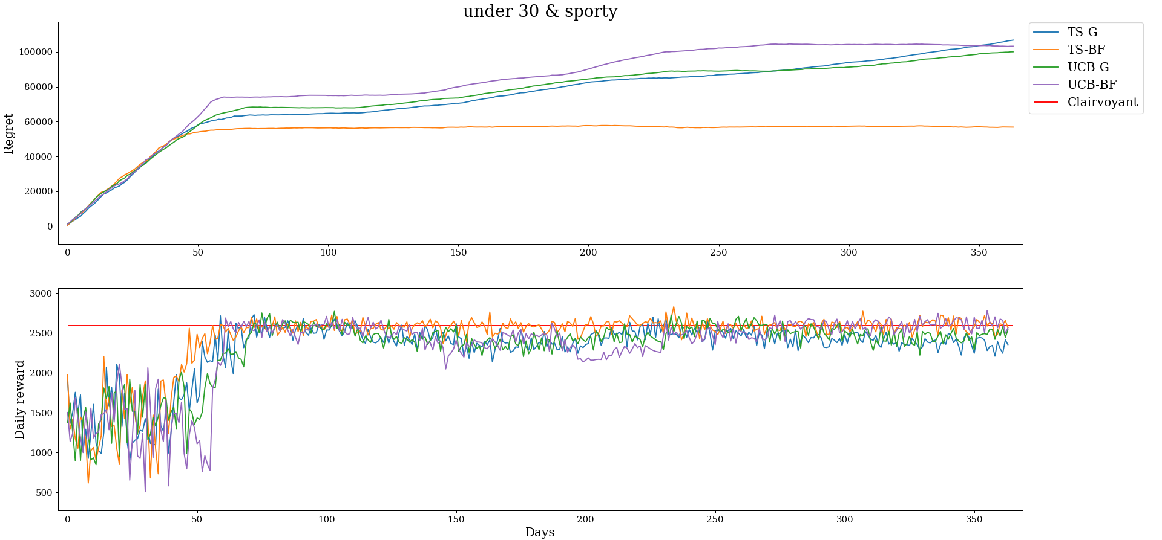
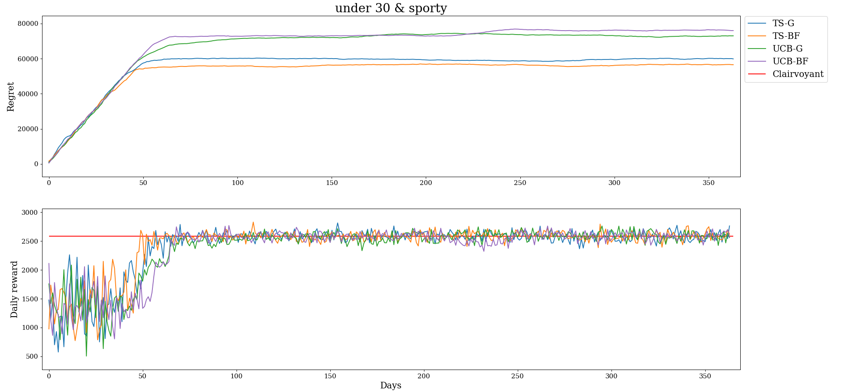
Pricing with discrimination
Generation from scratch
Incremental generation

Slide 16
Advertising under fixed price
With aggregated data conversion rate and expected returns depends also on the bid
For each bid estimate these two functions using the pricing TS learner
Gaussian distribution for cost per click, parameters are mean and standard deviation of observations
Gaussian distribution for daily clicks, two variants:
parameters estimated as the mean and standard deviation of observations
parameters estimated using a Gaussian Process regressor
At each round pull:
where daily clicks and cost per click are sampled from the distributions

Slide 17
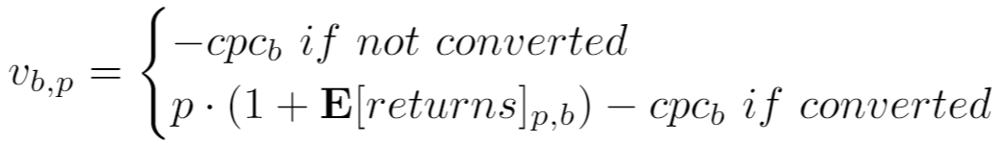
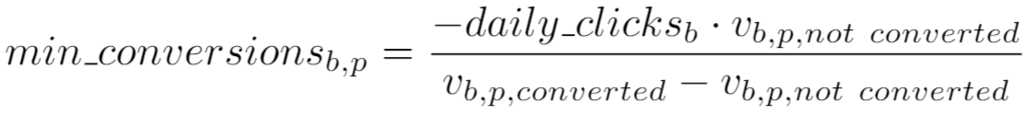
Negative rewards
Total reward for a price and a bid can be written as:
where the reward for a user is:
The min conversions for the total reward to be positive are:
Given estimated daily clicks and conversion rate:
We can calculate the probability that the number of conversion is less than the minimum

Slide 18
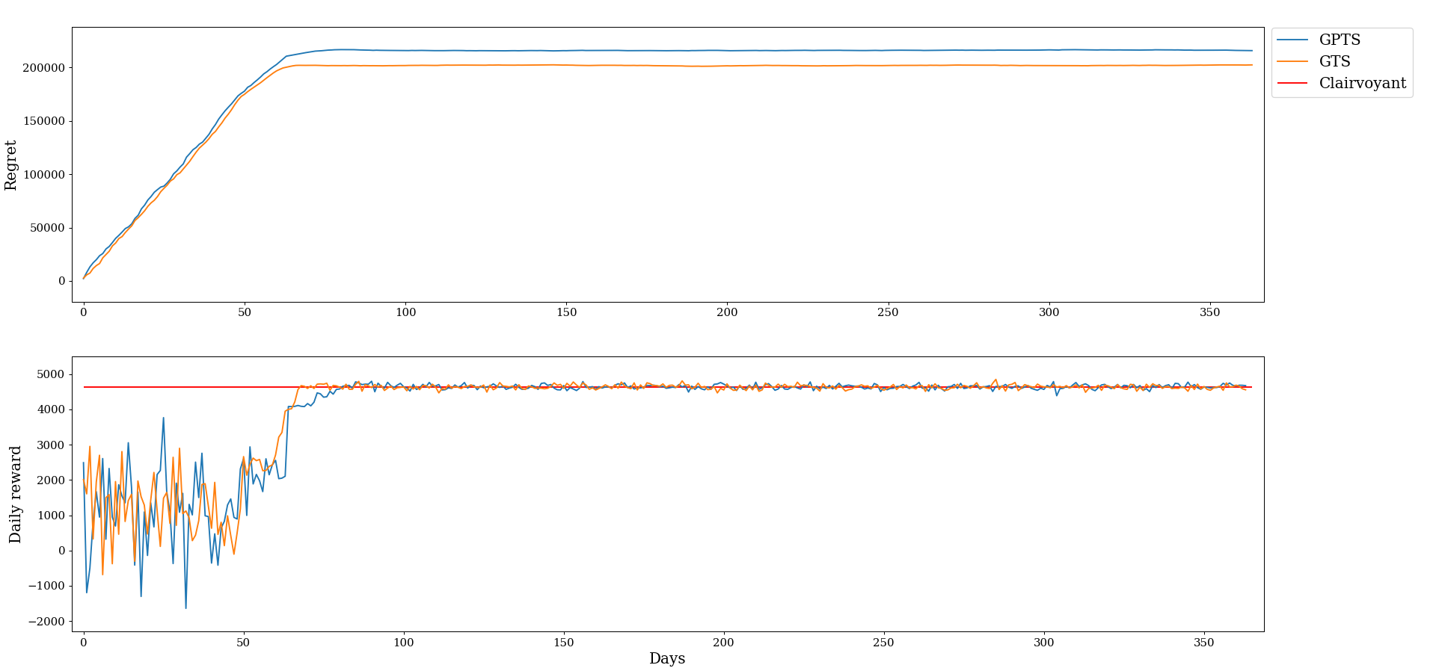
Advertising under fixed price

Slide 19
Joint pricing and advertising
Exact case
Approximation
One price TS learner for each bid
At each round one price is pulled for each bid and the relative estimation on conversion rates and returns are used for pulling the bid
The bid is pulled as in the case with fixed price but each bid will have different price, conv rate and expected returns
Assume the proportion of the daily clicks between the customer classes constant for each bid
Conversion rates and returns do not depend on the bid
Treat pricing and advertising as disjoint
Assumption holds in our scenario

Slide 20
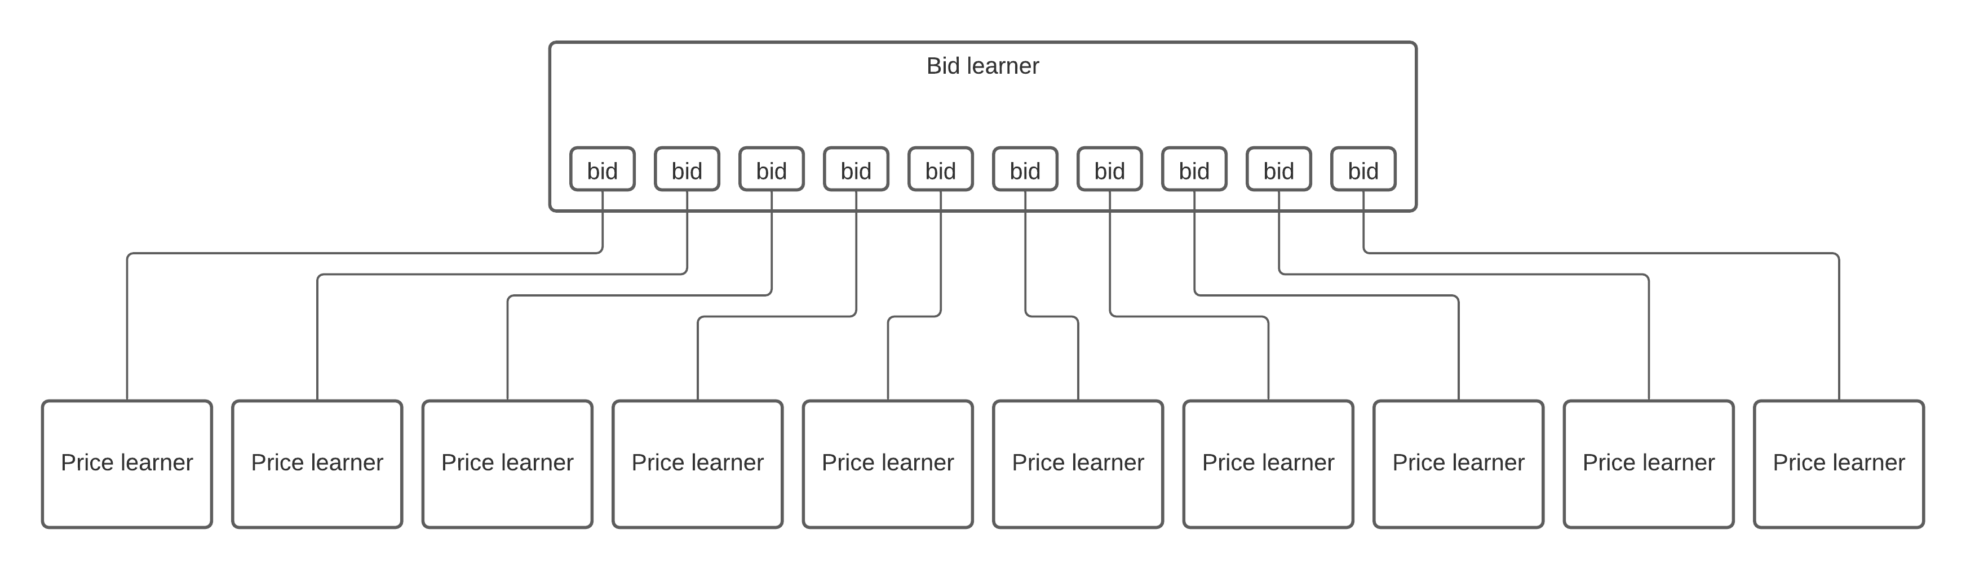
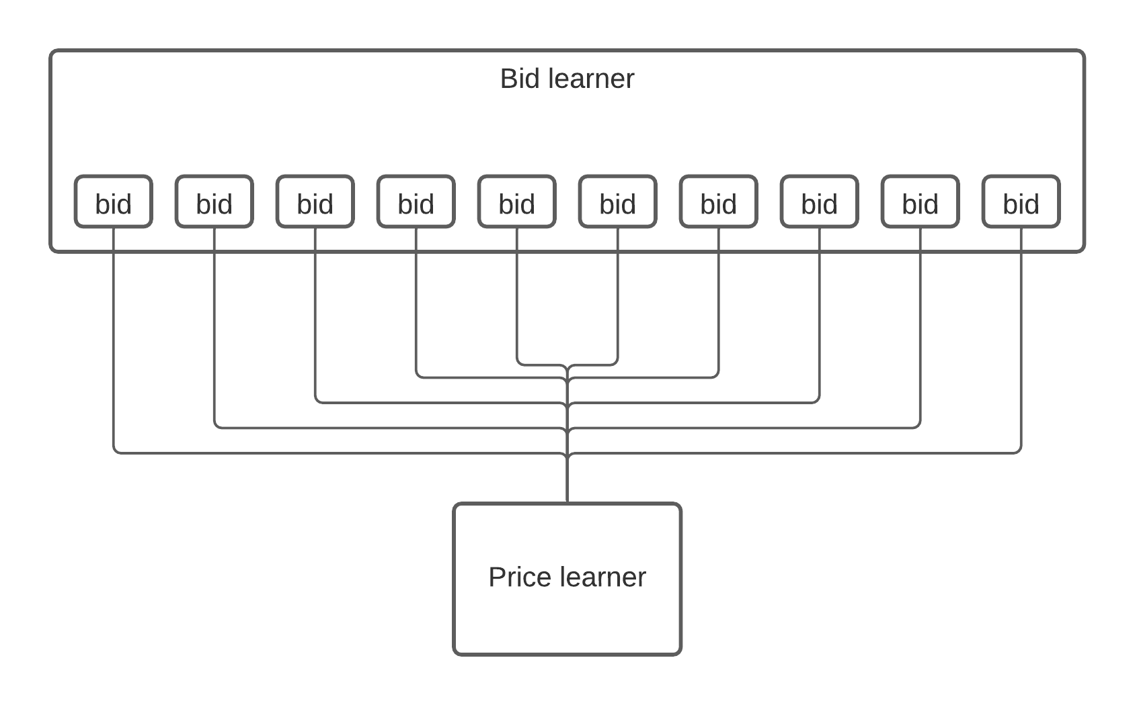
Joint pricing and advertising
Exact case
Approximated case

Slide 21
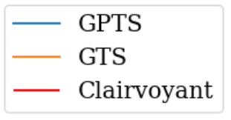
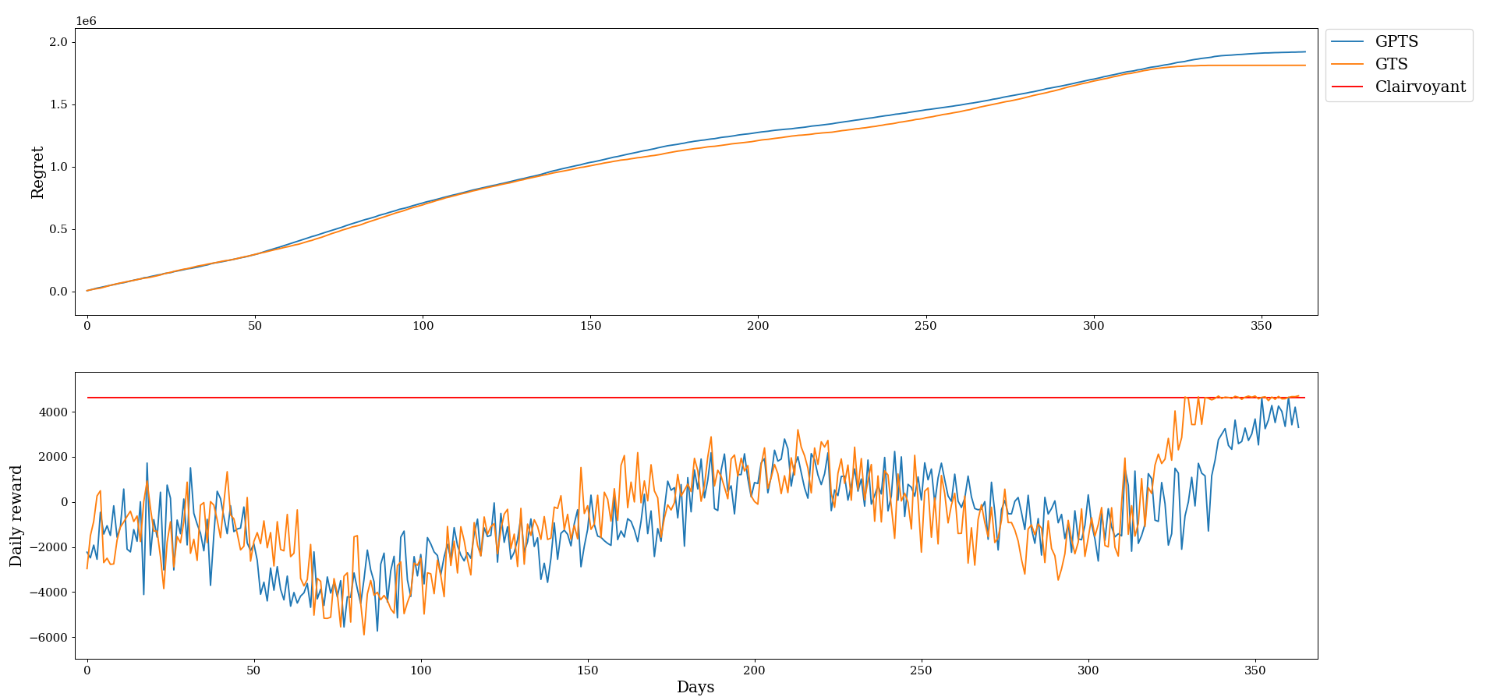
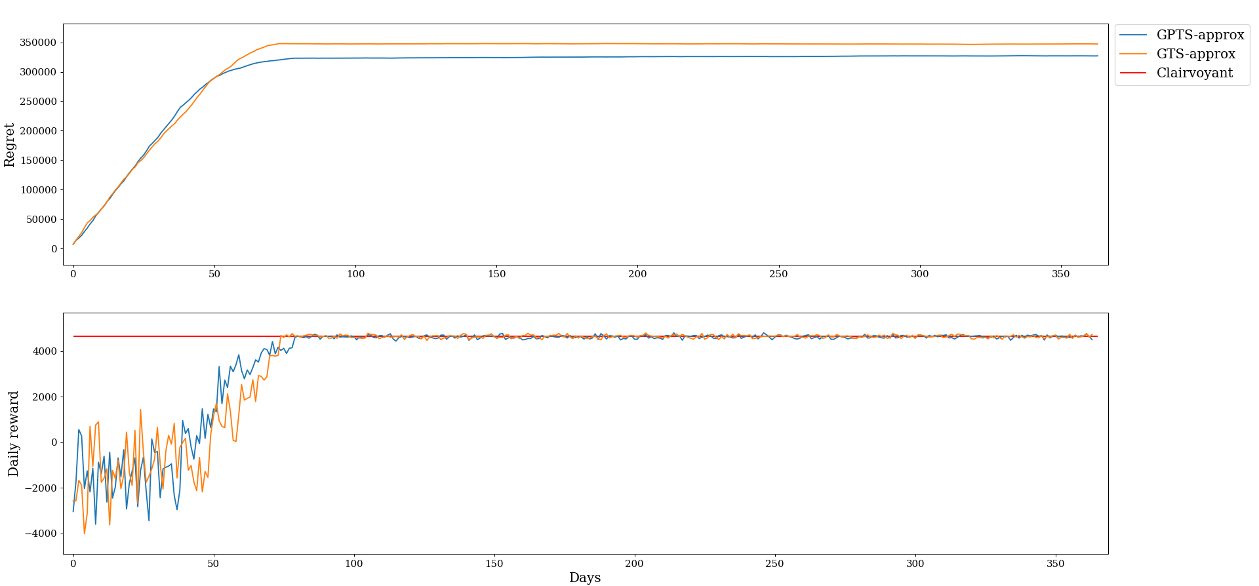
Joint pricing and advertising
Exact case
Approximated case

Slide 22
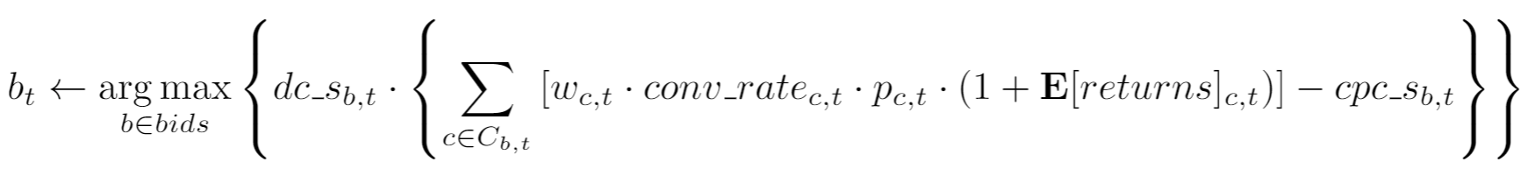
Joint with discrimination
Same as the case without discrimination but for each bid we have a context generator and we may potentially pull more than one price
At each round the bid is pulled as:
Also in this case we have the approximated version considering pricing and advertising as disjoint
Incremental and from scratch context generation are possible

Slide 23
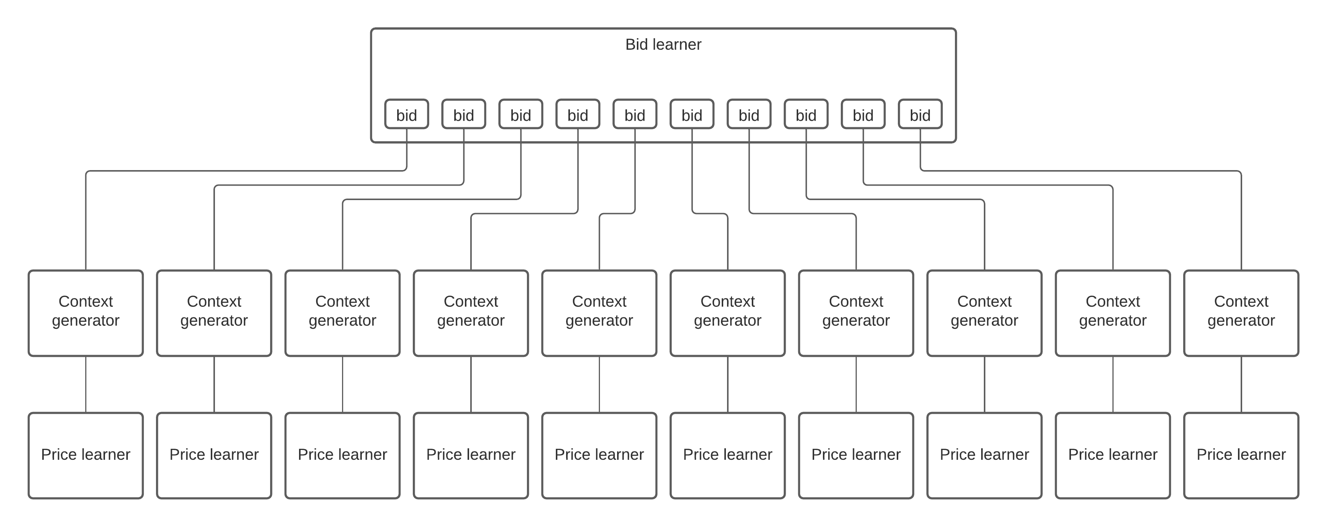
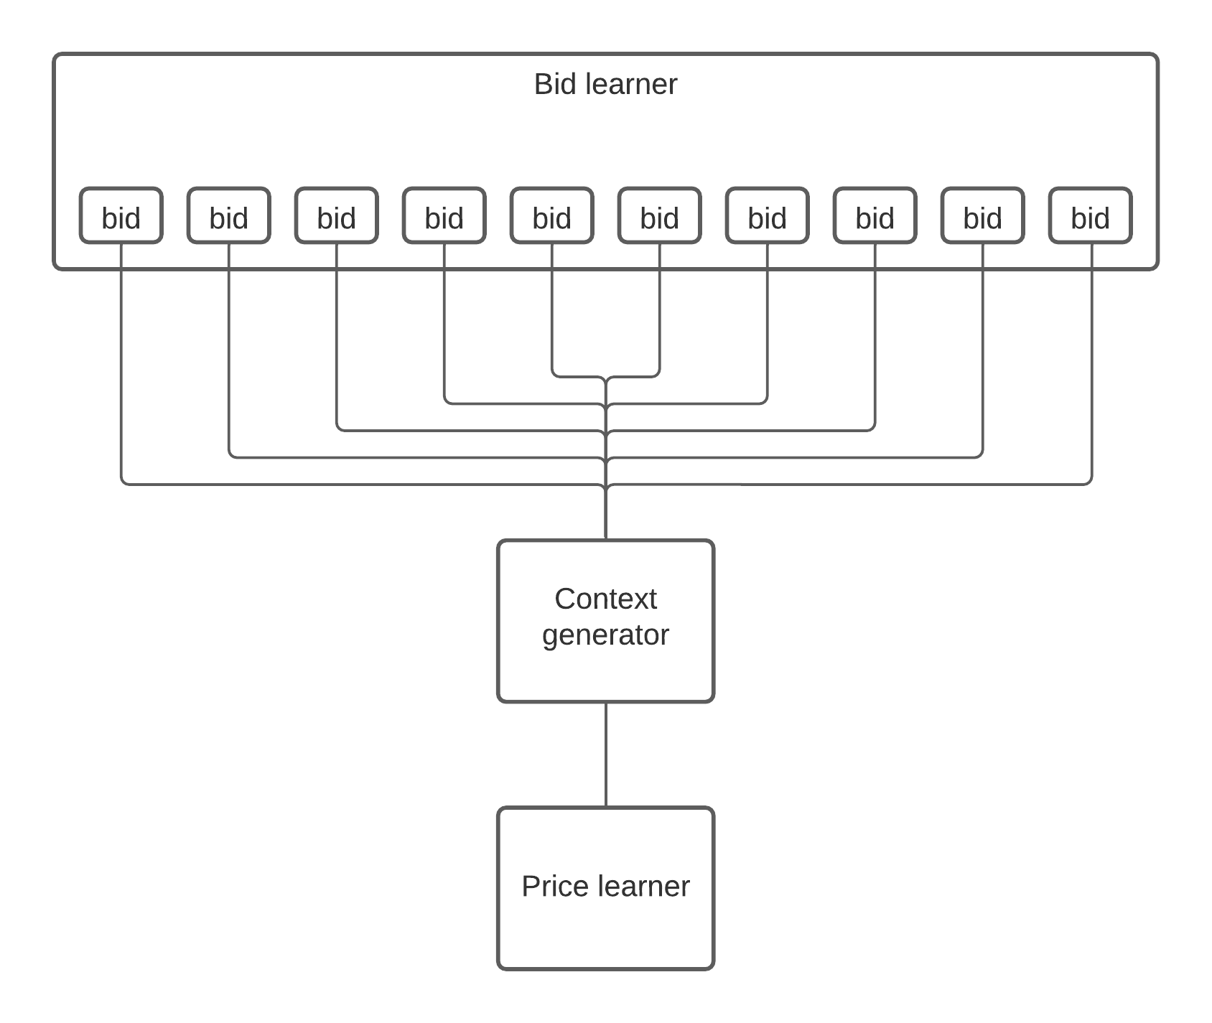
Joint with discrimination
Exact case
Approximated case

Slide 24
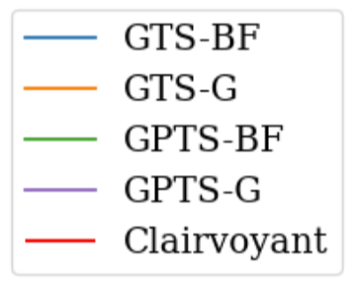
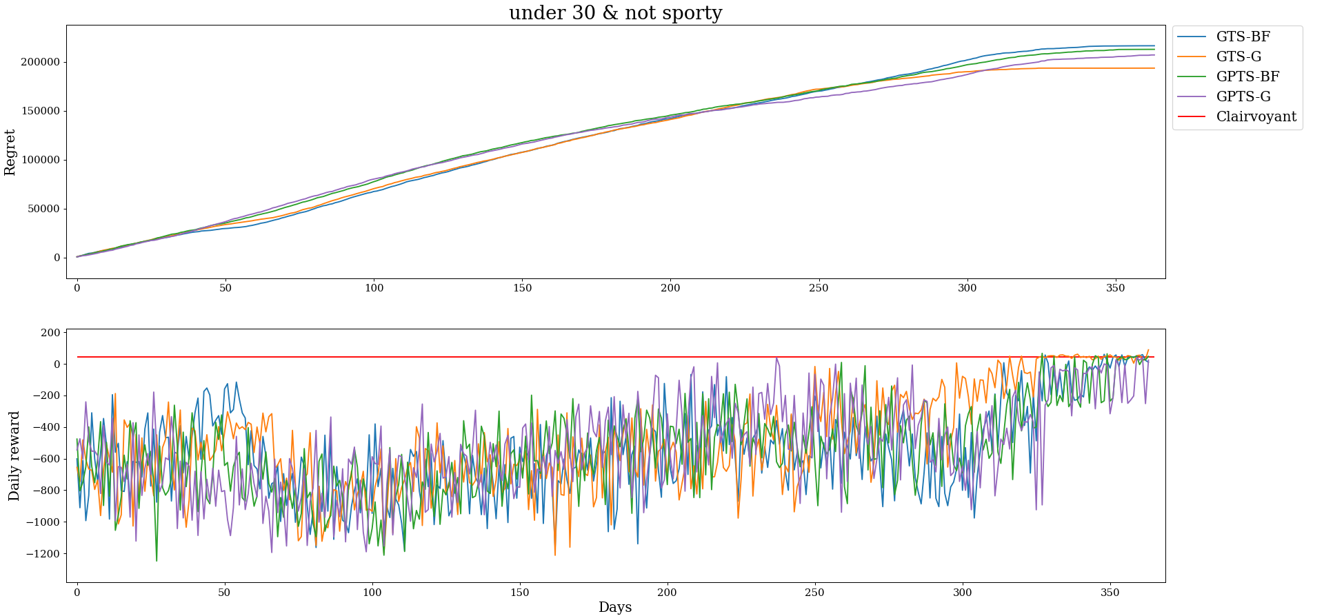
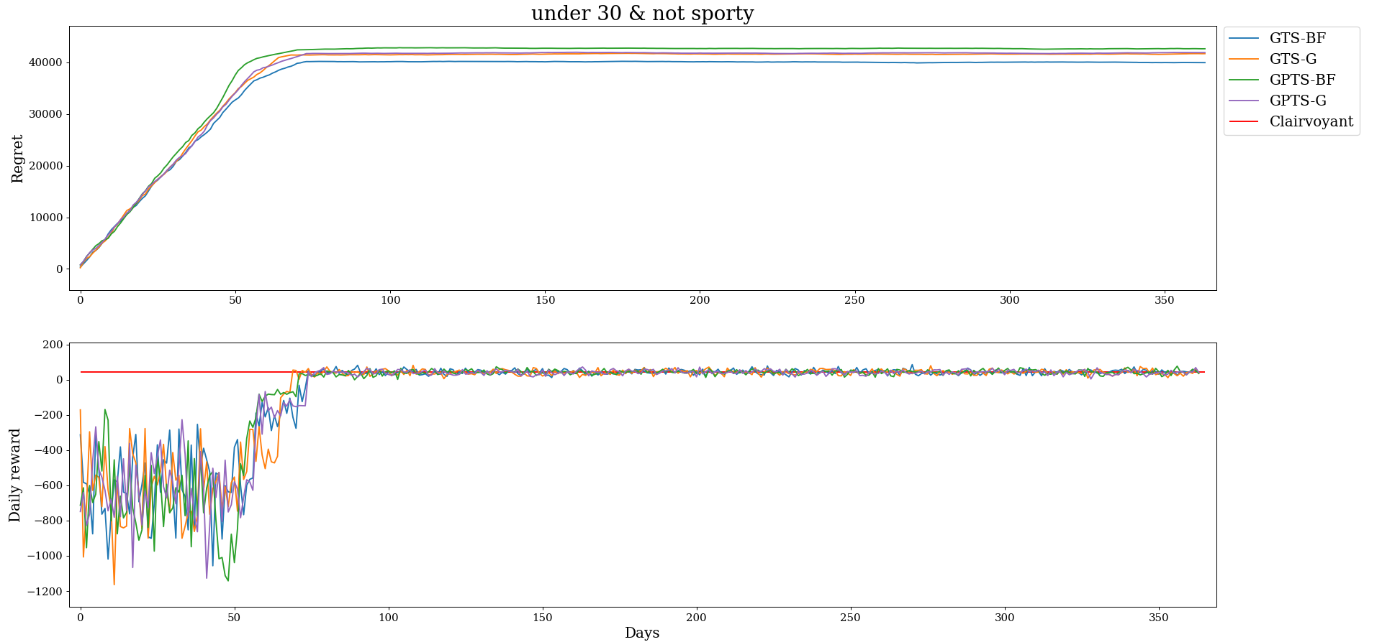
Joint with discrimination
Exact case
Approximated case

Slide 25
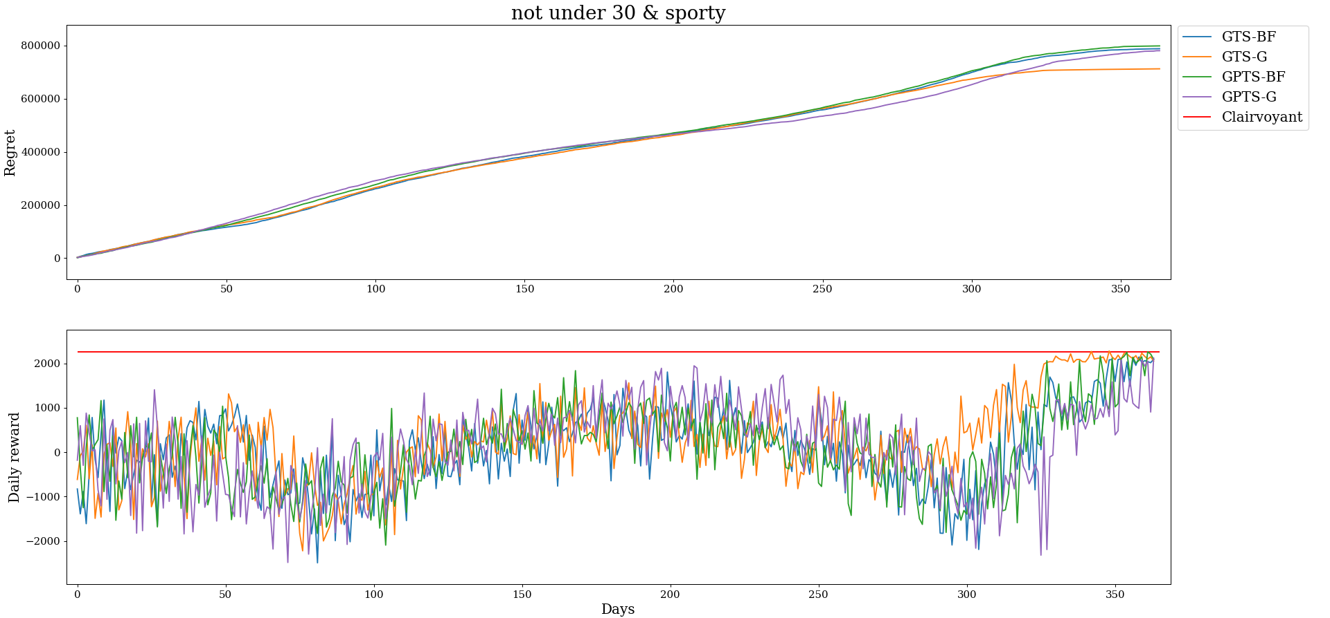
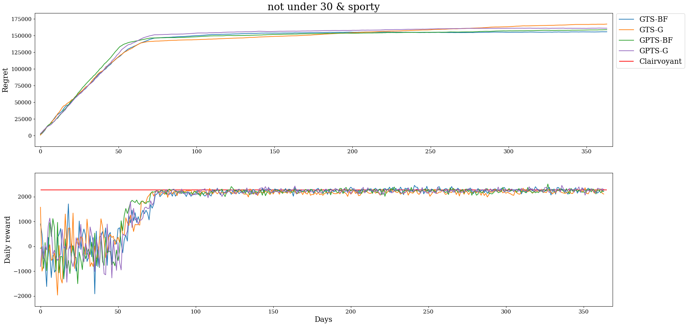
Joint with discrimination
Exact case
Approximated case

Slide 26
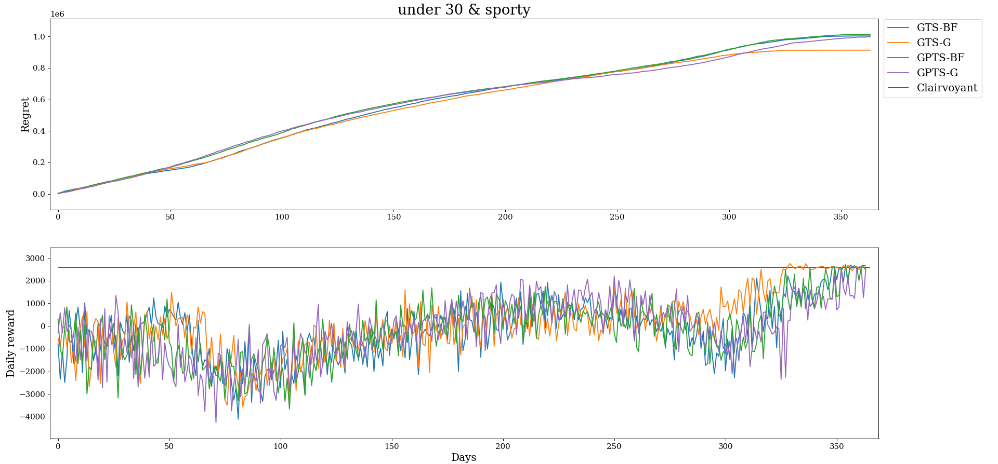
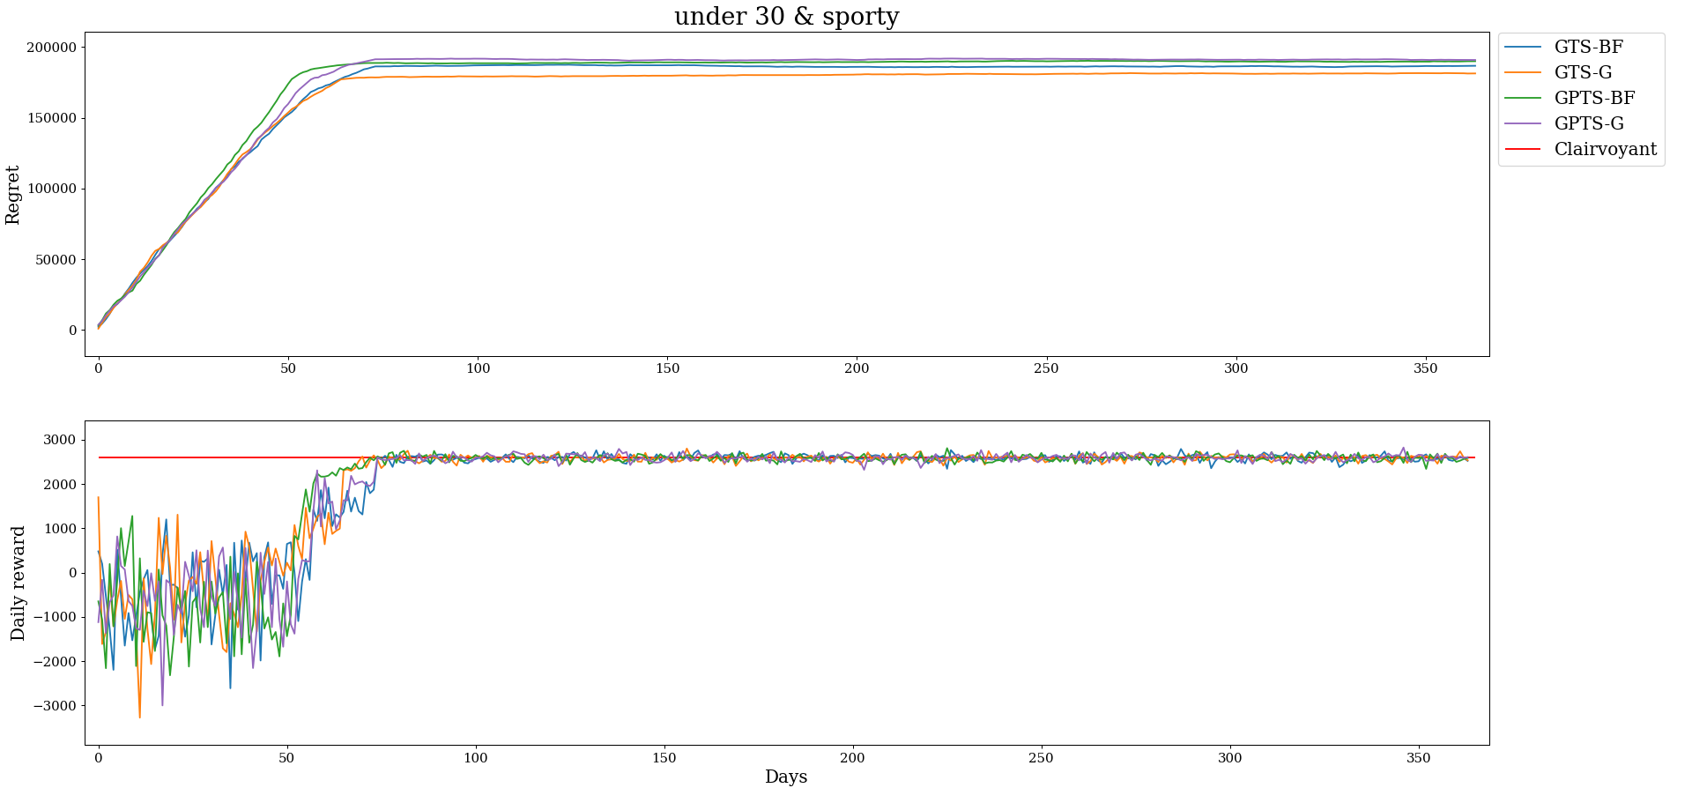
Joint with discrimination
Exact case
Approximated case

